Slide 1
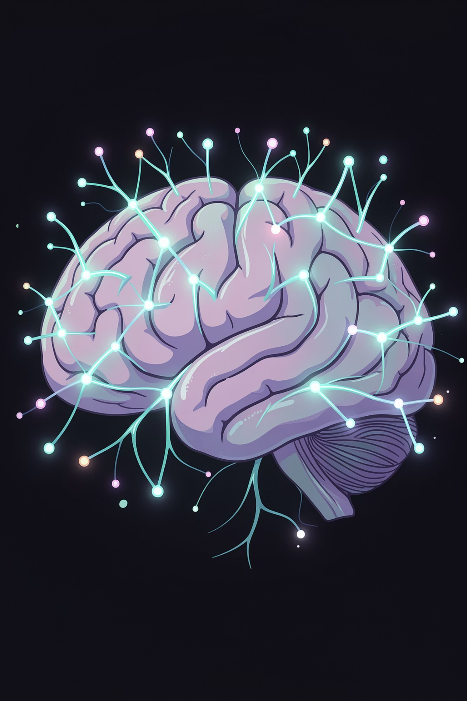
Depression Detection
An automated mental health risk detection system using social media text, combining classical machine learning with large language model (LLM)-based approaches.
MAJOR PROJECT PART-II · 15B19CI791
Students: Rishita Singh (9922102094), Shinthil Singh (9922103021), Shikhar Maheshwari (9922103029)
Supervisor: Dr. Devpriya Soni
Department: CSE & IT, JIIT Noida · April 2026

Slide 2

Chapter 1
Introduction & Problem Statement
Background
Depression affects millions globally. Traditional diagnostic methods are time-consuming, subjective, and hard to scale. As social media use rises, platforms like Reddit offer vast user-generated content revealing mental health signals.
The Challenge
Online posts use informal language, noise, and subtle cues — like distress patterns or implied suicidal intent — that conventional models struggle to capture consistently.
Scalability
Diversity
Generalization
Manual review of large social media volumes is impractical
Varied writing styles, noise, and class imbalance affect accuracy
Models often fail across different platforms and datasets

Slide 3

Chapter 1 · Solution Approach
System Overview & Novelty
A modular, end-to-end pipeline integrating classical NLP-based ML with LLM-based methods — enabling a unified comparison within a single framework.
Text Preprocessing
Classification
Feature Extraction
The novelty lies in combining supervised classifiers with prompt-based zero-shot and few-shot LLM inference, cross-domain transfer experiments, and detailed error analysis — all under consistent MiniLM embeddings for fair comparison.

Slide 4

Chapter 2
Literature Survey & Research Gaps
Evolution of Approaches
Key Research Gaps
Traditional ML
1
No unified comparison of ML, DL, and LLM approaches
TF-IDF, n-grams, LR/SVM — ~70–75% accuracy. Simple but no contextual understanding.
Lack of prompt sensitivity and few-shot vs zero-shot analysis
2
Deep Learning
LSTM/CNN — ~78%. Captures sequence dependencies but needs large labelled data.
Limited cross-domain testing across platforms
Transformers
3
BERT/SBERT — ~80–85%. Strong context, but high computational cost.
Most studies skip detailed error analysis
4
LLMs
Zero-shot/few-shot — ~55–70%. No training needed, but prompt-dependent.

Slide 5
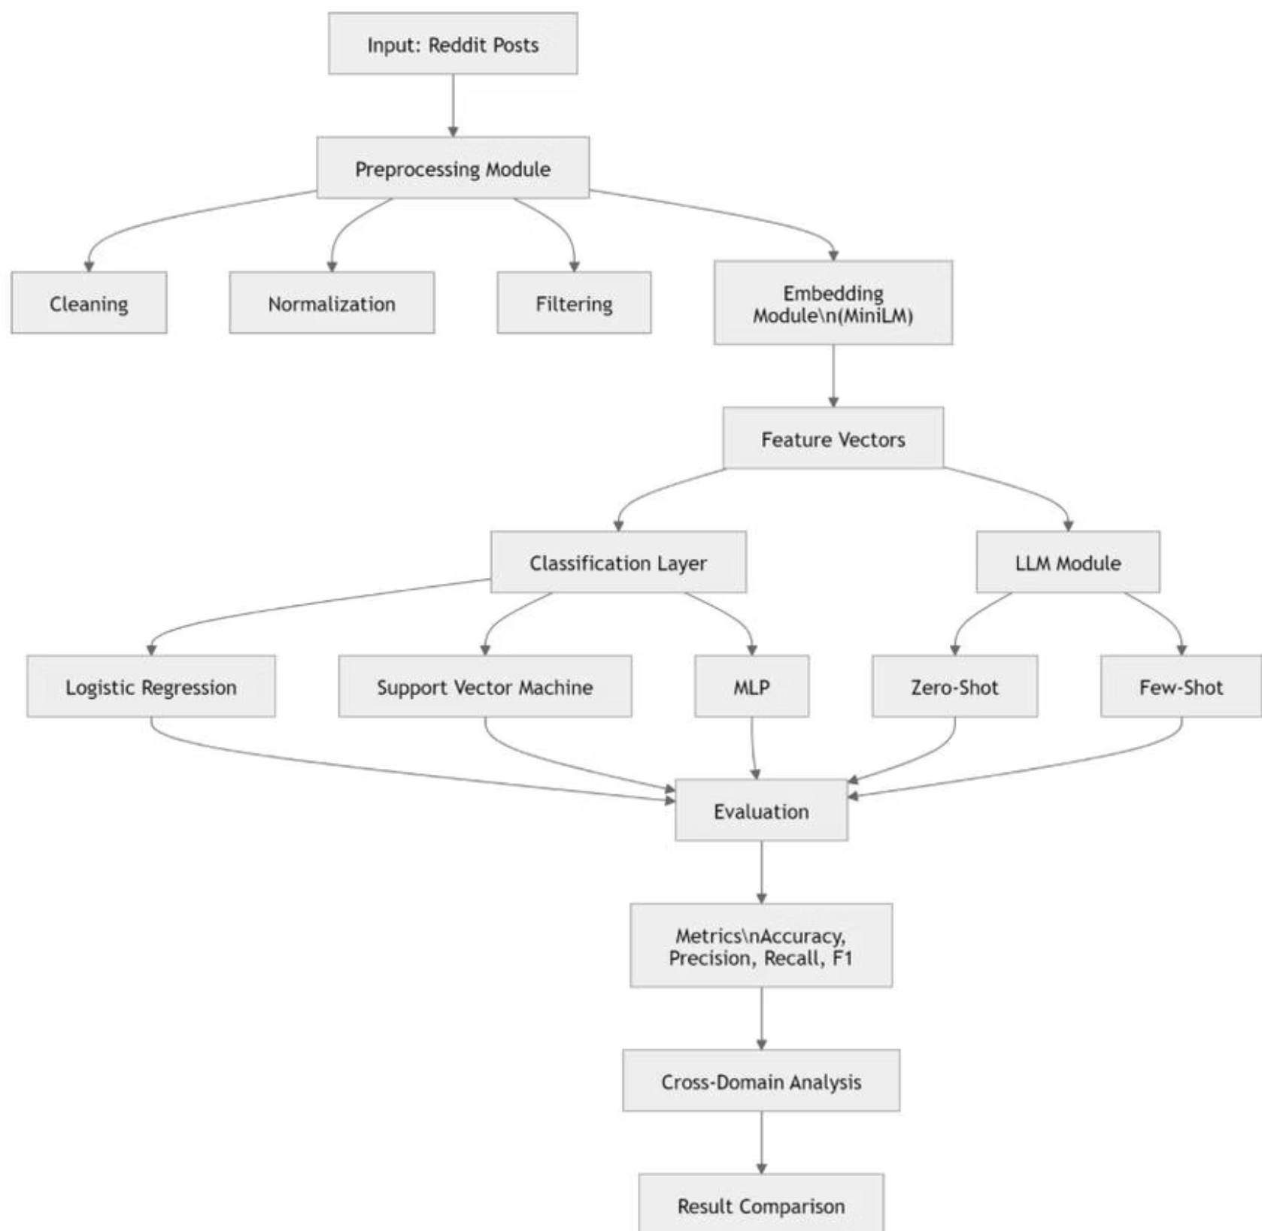
Chapter 3
System Architecture & Methodology
Pipeline Stages
01
Data Collection
Reddit posts from depression, anxiety, and suicide watch communities
02
Preprocessing
Remove URLs, mentions, special characters; normalize and filter
03
MiniLM Embeddings
Convert cleaned text to dense semantic vectors (all-MiniLM-L6-v2)
04
Classification & Evaluation
LR, SVM, MLP + Zero/Few-shot LLM; metrics: Accuracy, Precision, Recall, F1

Slide 6

Chapter 3 · Design Choices
Tools, Techniques & Modelling
Python Stack
Pandas, NumPy, Scikit-learn, Sentence Transformers, Matplotlib/Seaborn
Why MiniLM?
Lightweight, CPU-efficient, captures semantic meaning; embeddings reusable across all classifiers
Why Classical Models?
Interpretable, efficient training, strong baselines — LR (linear), SVM (margin), MLP (non-linear)
Why LLMs?
Zero-shot inference without training; useful in low-data scenarios using BART (facebook/bart-large-mnli)

Slide 7

Chapter 4
Implementation & Testing
Experimental Setup
Sample Test Cases
Hardware
Sample Size
Input Text
Expected
Result
Standard CPU (8–16 GB RAM), no GPU required
200 balanced posts; stratified cross-validation
"I feel very lonely and lost"
MH Risk
✅ Correct
"I want to end everything"
High Risk
✅ Correct
LLM Model
facebook/bart-large-mnli for zero-shot classification
"I am tired but managing"
MH Risk
❌ Incorrect
"Nothing matters anymore"
High Risk
❌ Incorrect
System designed for assistive analysis only — not clinical diagnosis. Human review required for flagged cases.

Slide 8
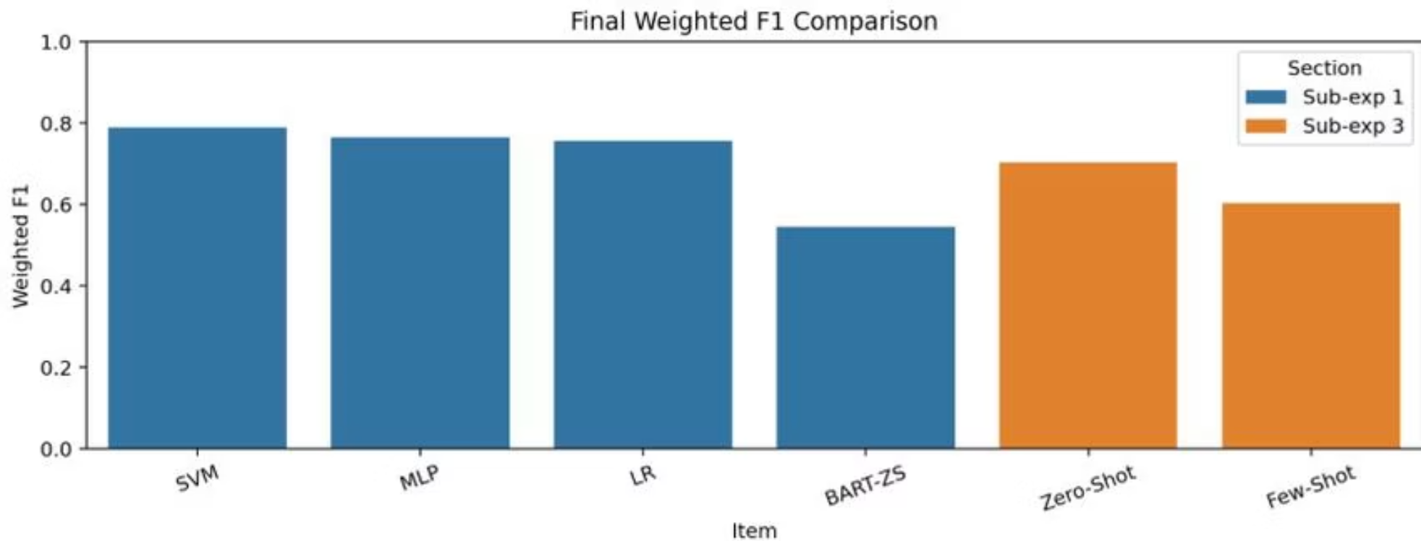
Chapter 5
Results: Classical ML vs LLM Performance
Key Findings
SVM — Best Performer
~79% accuracy, ~0.79 weighted F1. Effective margin-based separation of embeddings.
MLP & LR
~77% and ~76% F1 respectively. All classical models outperform LLM-based methods.
Zero-shot LLM
~0.70 F1 with best prompt — viable in low-data settings but unstable.
BART Zero-shot
~0.55 F1 — weakest performer; confirms LLMs need careful prompt design.

Slide 9
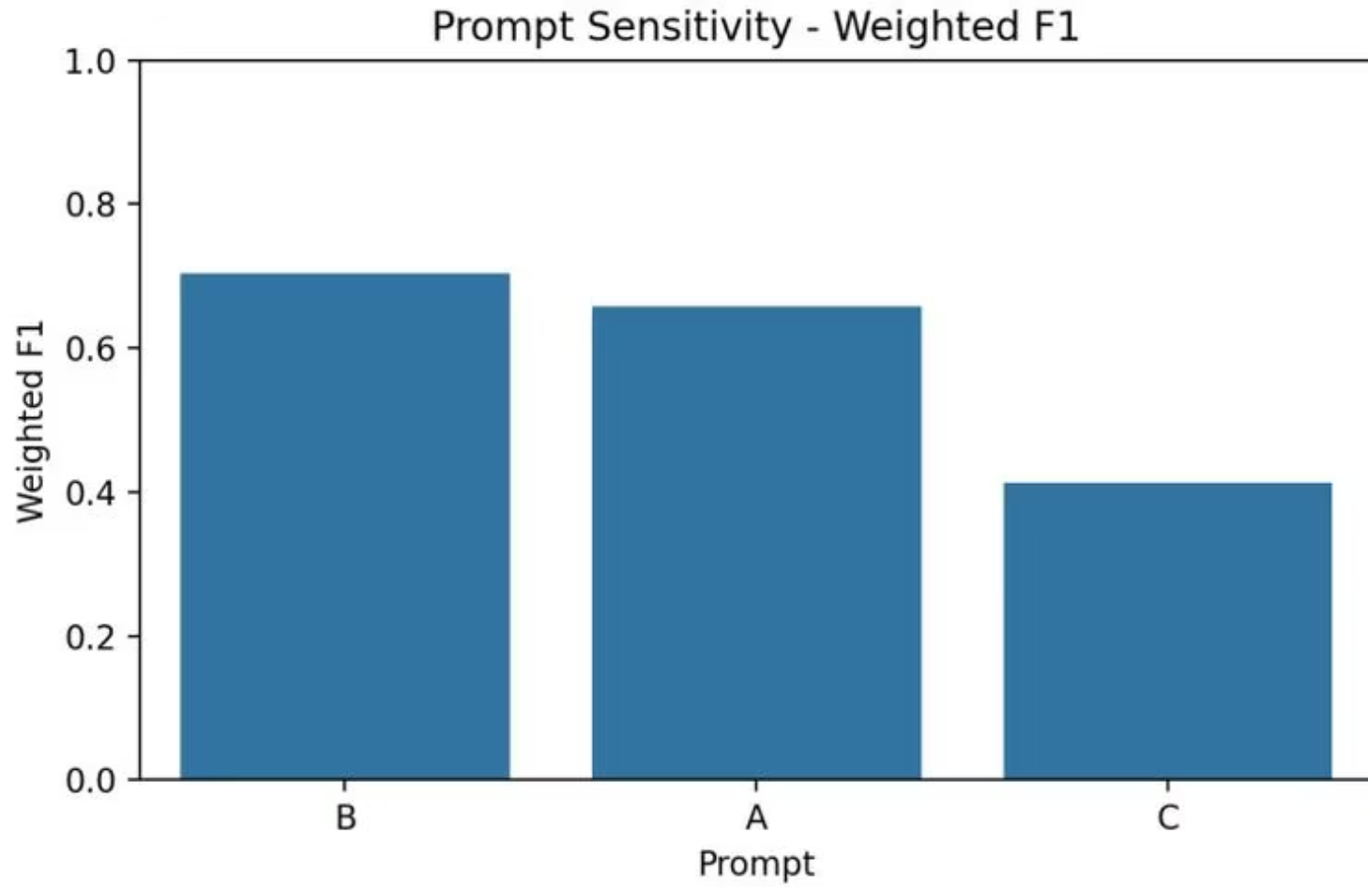



Chapter 5 · Deep Dive
Prompt Sensitivity, Error Analysis & Cross-Domain
Prompt B (~0.70 F1) vs Prompt C (~0.41 F1) — a 30-point gap from prompt wording alone.
Error Analysis Distribution
52%
25%
17%
Agreement Correct
LLM Advantage
Classical Advantage
Both ML and LLM agree on correct prediction
LLM better on context-heavy cases
ML better on structured patterns
Zero-shot shows bias toward majority class — high false negatives in high-risk suicidal cases (64 misclassified out of 100).

Slide 10


Chapter 6
Conclusion & Future Scope
Achievements
Future Directions
SVM achieved best performance
Fine-tune BERT/RoBERTa for improved contextual classification
~79% accuracy and F1 using MiniLM embeddings on Reddit data
Add multimodal data — speech, facial expressions, behavioural cues
Unified ML + LLM framework
Automatic prompt optimisation for LLM-based inference
First comparison of classical models and zero/few-shot LLMs in a single pipeline
Real-time social media monitoring with human-in-the-loop safeguards
Cost-effective & scalable
This system acts as an assistive screening tool — supporting early intervention in mental health with ethical, scalable, and reproducible AI.
CPU-based, open-source, no paid APIs — suitable for resource-constrained environments

